Slide 1
Intro to PERA
PERA prohibits recording and distribution of this presentation.
Notes:
Greetings! My name’s Desi, I’m an outreach/educ specialist, & I’ll be walking u thru 2day’s program, Intro to PERA.
If ur new to PERA, ur in the right place, as this prezo is going to give u a quick overview of PERA, & equip u w/ basic knowledge of the plans we administer.

Slide 2

Agenda
PERA’s Pension Plans
Public Employees DCP
Resources
Notes:
Today’s prezo is going to run about 15mins, & this is the agenda.
1st, we’re going to discuss the plan options we have at PERA, including PERA’s 3 trad pens plans, as well as the Pub EE’s DCP.
& once we’ve wrapped that up, I’ll show u where to find resources on our website.

Slide 3

PERA’s Pension Plans
Notes:
In our 1st section, I will discuss the pension plans we have at PERA.

Slide 4

What is a Pension?
What is a Pension?
A retirement plan paid into while working that provides a future monthly lifetime income
Funds are professionally managed by the Minnesota State Board of Investment
Future benefit amount based on a formula
Notes:
Some of U may B brand-new 2 administering a pens, so let's start w/ “what is a pens?”
A pens—also referred to as a defined benefit plan—is a retirement plan that members pay into while working that provides them w/ future a mnthly lifetime income.
While working for a PERA-covered ER, members will contribute a % of each of their paychecks to the plan.
*These funds are then pro managed & invested by MN SBI.
So members don’t make invest decisions w/ their contributions, making the pens a hands-off retirement plan.
& a pens is not like a 401k, where the retirement account is determ’d by how much $ was contributed & how well the market performed.
*Instead, the pens is calc’d on a formula that takes into account the member’s YOS & ave sal.

Slide 5

Pension Plan Participation
Participation is required if:
Employee exceeds $425 monthly salary threshold; and
No exclusions apply
Membership Eligibility
Notes:
Participation in a PERA pens plan is required of EE’s if both of these rules apply to them.
1st, if they exceed sal thresh of 425 w/in a month. So, if an EE earns more than 425 w/in any month.
& 2nd, no exclusions apply to the EE. Common exclusions that disqualify an EE fr/ membership would be EE’s who are FT students under the age of 23, seas/temp EE’s, as well as PERA retirees.
& u can find the full list of exclusions in ch 3 of the ER man.
So participation is required of most PT & FT EE’s.

Slide 6


Three Pension Plans
Employee
Contributions
Employer
Contributions
Coordinated
Plan
6.50%
7.50%
Police & Fire
Plan
11.80%
17.70%
Correctional
Plan
6.83%
10.25%
Notes:
We administer 3 pens plans here @ PERA: the Coord P, P&F, & Corr P.
Once ur EE gains membrshp in a plan, a % of each paycheck’s deducted, & these deductns are their member contrbtns.
U the ER will also contribute % of each paycheck, & the ER & EE contribtns R pooled together & investd by SBI to help fund pens.
Now, the % the EE & ER contribute differs depending on which plan, which u can see listed here.
Coord members contribute 6.5% of each paycheck, & their ER contributes 7.5%;
P&F members contribute 11.8% of each paycheck, & their ER contributes 17.7%;
& Corr members contribute 6.83% of each paycheck, & their ER contributes 10.25%.
These rates are set by statute, & subject 2 legisl change. Later in this prezo, I will show u where on our website u can find current contribution rates.
Now, since we have 3 pens plans at PERA, u may be wondering how to know which plan to enroll ur EE into.

Slide 7

Coordinated Plan Membership
Coordinated Plan — Minn. Stat. § 353.01, subd. 2a or 2d
Largest of PERA’s three pension plans
For most full or part-time permanent employees, including non-certified employees of independent school districts
Notes:
Let’s start w/ the Coord Plan, which is the largest of PERA’s 3 pension plans.
This plan is mandated for pos’s that meet the membership requirements listed in MN Stat. §353.01, subd. 2a or 2d.
The Coord plan covers most FT or PT permanent EEs, including non-certified EEs of independent school districts.
& this is the plan most of ur EE’s will be enrolled in.

Slide 8
Police & Fire Plan Membership
Police & Fire Plan —
Minn. Stat. § 353.64
For full-time police officers and full-time professional firefighters
Part-time police officers and firefighters can be enrolled with a resolution
If no resolution is provided, default plan is Coordinated
Notes:
The P&F Plan is PERA’s 2nd largest plan, & its mandated for FT police officers & FT pro ff’s as defined in MN stat. § 353.64
*Now, PT police officers & PT firefighters can be enrolled in this plan, but only w/ a signed resolution fr/ the governing board.
Ur unit can pass a single rezo for 1 EE, or u can pass a blanket rezo for any & all future PT EE’s.
If no resolution is provided, the default plan for PT police officers & firefighters is the Coord plan.

Slide 9
Correctional Plan Membership
Correctional Plan —
Minn. Stat. § 353E.02
For correctional guards or officers, a joint jailer/dispatcher, or a supervisor of these positions
Must be working in a county, regional adult, or juvenile correctional facility
Notes:
& then we have the Corr Plan, which is the smallest of PERA’s 3 pens plans.
This plan covers corr EE’s who meet the eligibility criteria listed in MN Stat. § 353E.02.
So that would include correctional guards or officers, a joint jailer/dispatcher, or a supervisor of these positions.
& these EE’s must be working in a county, regional adult, or juvenile correctional facility in order to be elig for the Corr plan.

Slide 10
Pension Formula
Calculated on Three Factors
Years of Service
Average Monthly Salary
Age
Notes:
Another thing u should know about PERA’s pensions, is how we calculate member’s benefits.
PERA pensions are calc’d on a formula using these 3 factors: the member’s YOS, their ave sal, & age at retirement.
PERA will replace a % of the member’s sal for each YOS they give. & the % PERA will replace differs for each plan.
When it comes to the member’s ave sal, we use the 5 consecutive yrs that the member’s sal was the highest. We commonly refer to this a the member’s “high-5”.
As for age, only a factor if a member begins drawing their pension B4 their plan’s FRA.
The FRA for Coord members is 66, but they can begin drawing as early as age 55. & the FRA for Corr & P&F is 55, but they can begin drawing as early as age 50.
Altho most retirees will draw out everything they paid into PERA w/in their 1st 3 yrs of beginning their benefit, PERA will continue paying members 4 the remainder of lifetime. Again, this is a lifetime benefit, & members cannot outlive their pension.

Slide 11

Public Employees DCP
Notes:
In our next section, I will cover the Public EEs Def Contr Plan—aka, the Pub EE’s DCP—which differs fr/ PERA’s 3 pension plans.

Slide 12

Public Employees DCP
Public Employees DCP
Member and/or employer contribute % of gross eligible salary from each paycheck
Member makes investment decisions
Funds grow tax-deferred until retirement
Notes:
The Public EEs DCP only covers individuals in spec pos’s, such as pub officials, city managers, physicians, & certain ambulance rescue personnel.
The DCP is a 401(a) tax-qual retire plan, in which the member &/or ER contribute a % of elig sal fr/ each paycheck.
The % contributed, & whether the member &/or ER contribute, differs depending on which of our 5 Def Contr Plans the indiv is covered under.
*These contributns are deposited into the membr’s account, & its up to the member to decide how the funds are invested.
*& Bcuz the DCP is a tax-qual plan, the funds will grow tax deferred, & the member doesn’t have to pay taxes until they w/draw the $.

Slide 13
DCP Participation
Agenda
Public Employees DCP Participation
Participation is optional:
If it is the employee’s first PERA eligibility with that unit, and
It is within 30 days of their first day of work in a DCP-eligible position with that employer
Participation is mandatory:
If the employee previously had PERA coverage with the same employer that they are now in a DCP-eligible position for
Notes:
Participation in the Pub EE’s DCP is optional for some, while it’s mandatory for others.
Participation is optional if it’s the EE’s 1st time being elig for PERA coverage at the unit which they’re newly employed by, but it’s only an opt w/in their 1st 30 days of work.
Theses EE’s must make their decision of whether to join the DCP, or to opt out, w/in those 30 days. If the EE doesn’t make a decision w/in that time frame, they will not have optional PERA coverage w/ that ER.
*On the flip side, PERA participation is mandatory for an EE if they previously had any type of PERA coverage w/ the same ER that they are now in a DCP-elig pos for.
So if the EE was previously covered by—& the ER had contributed to—any PERA plan, or a supplemental pens or deferred compensation plan under MN. Stat. § 356.24
For ex, u have a long-term EE who works in maintenance at ur township, who has been paying into the Coord P during that time.
& then they later accept a 2nd pos at ur unit that is elig for DCP. In that case, the EE would be required to participate in the DCP.

Slide 14

Public Employees DCP
No salary requirements
Contributions go towards purchasing shares
Lump-sum payout—no monthly benefits
Notes:
1st, there’s no min sal requirement 4 membrship.
*Contributions that the member &/or ER make are used to purch shares in 1 or more of 7 Invest Fund accounts.
The member’s future ben is determined by the contribution amounts, & the performance of the investments.
Account balance is affected by market fluctuation & can change on daily basis, & PERA & the State of MN cannot guarantee that the account value wont decrease to a level below what was originally paid for the shares.
*Another important tenet of this plan, is how the future ben is paid out, which in most cases is as a 1-time lump sum.
I wanna emphasize this point, Bcuz people tend 2 get the DCP confused w/ PERA’s pens plans, which give members a mnthly lifetime ben.
W/ the DCP, there are no mnthly bens– the ben is strictly paid out as a 1-time lump sum.
.

Slide 15
Agenda
DCP vs. Pension Plans
Defined Contribution Plan
Payment based on amount of contributions and investment performance
Member makes investment decisions
One-time lump sum
PERA’s Pension Plans
Payment based on average salary, years of service, and age at retirement
SBI manages investments on member’s behalf
Lifetime monthly benefit
Notes:
To help clarify the difference between the Pub EE’s Def Contr Plan & PERA’s a pens plans, lets compare & contrast the 2.
1 of the main diff’s between these plans is how the ben payment is calc’d.
The DCP ben is based on how much the member & the ER contribute, as well as how well investments perform.
Conversely, w/ PERA’s pens plans the ben amount is calc’d on formula using the member’s highest ave sal, YOS, & age at retirement.
Meaning it doesn’t tech matter how much the member contributes, & their ben is not affected by market fluctuations.
*Another differ’s is investment decisions. W/ the DCP, the member the 1 in control of deciding how the contributions are invested.
Meanwhile w/ a pens plan, the MN State Board of Investment manages the funds on the member’s behalf, so it’s maintenance free for the member.
*& lastly, the way the ben is paid out. As mentioned, the Pub EE’s DCP is paid out as a 1-time lump sum of the member’s account balance, & no further payments will occur.
Whereas PERA’s pensions pay out a set amount, every mnth, 4 the rest of the member’s lifetime—regardless of the member’s account balance.
Most pens plan membrs will w/draw their entire account balance w/in 2-3 yrs, but PERA will continue their mnthly payments for the remainder of life.
PERA’s pens plans also have survivor opts in case the member wants 2 xtend their ben 2 cover another person after their death.

Slide 16

Resources
Notes:
In our final section, I’ll be sharing some helpful resources regarding the information shared today.

Slide 17


www.mnpera.org/
We’re Here to Help!
www.mnpera.org
www.mnera.org
Notes:
On PERA’s main website, mnpera.org.
To find PERA’s ER website, u will select *“For ER’s” fr/ the top left corner.

Slide 18




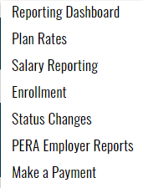


www.mnpera.org/employers
Notes:
*Under the Reporting dashboard, u can find a wealth of info, *including current plan rates.
*Under the Resources dashboard, u can find the *ER Man towards the bottom of the drop-down menu. All of the chapters have great info, & we recommend starting w/ chapters 3-7 to give u a concrete foundation as an ER contact.
To find other webinars, *u will select ER Programs.

Slide 19

www.mnpera.org/employers/resources/employer
Notes:
& that will bring u here.
On our ER program page, we have numerous on-demand webinars covering a multitude of topics, which u can watch at ur convenience.
We suggest that u scroll thru this page to find webinars based off ur interests, or position responsibilities related to PERA.
Now, if u ever have a Q, or if u need to contact us for any reason, u can find our Contact page by clicking *“Contact” in the upper right corner.

Slide 20

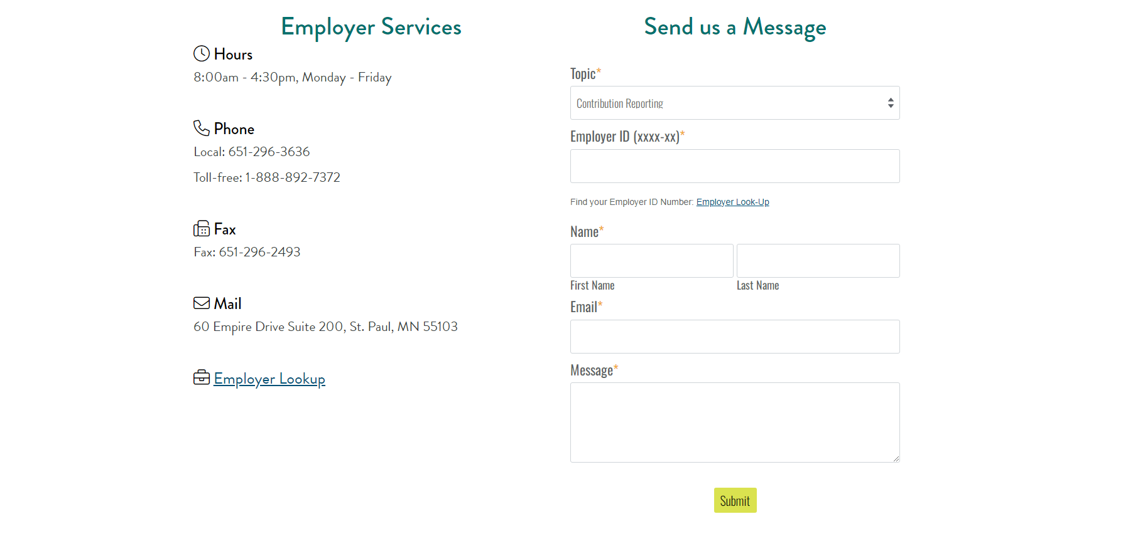
www.mnpera.org/employers/contact
Notes:
That will take u here, where u will find several opt’s for getting in touch w/ us.
Lets scroll down a bit…

Slide 21
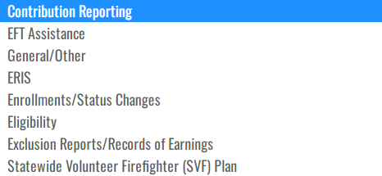
www.mnpera.org/employers/contact
Notes:
On the right, u can see a feature that allows U2 send us a secure message.
*At the top, it asks 4U2 select a spec topic for ur message, & u can choose fr/ the opt’s on this drop down.
*Make sure u fill in all the required info, & when u hit submit, it will send the message directly to us.
When it comes to email, we discourage sending private info, but u can send us private info using this feature here, as our system keeps the info secure.
Also, depending on what topic u’ve selected, there is the opt to attach a file, which is also sent securely.
Lets scroll down a little more…

Slide 22
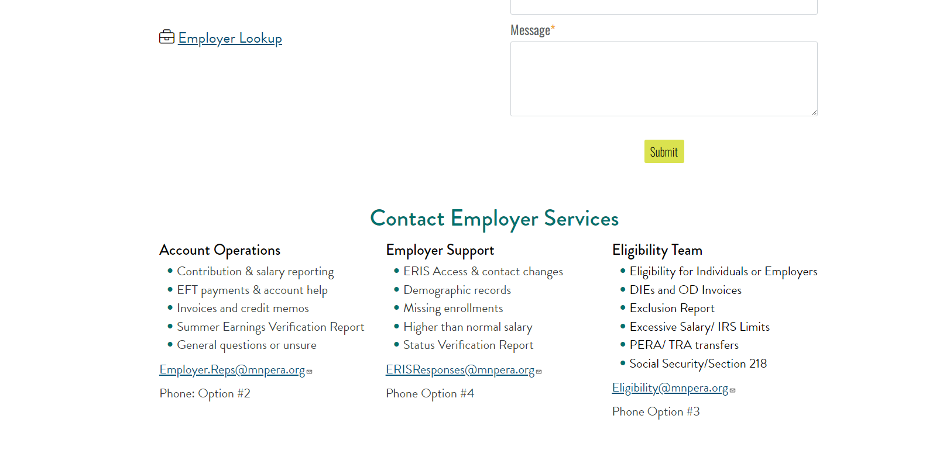
www.mnpera.org/employers/contact
Notes:
At the bottom, u’ll see our 3 ER teams—Account operations, ER support, & the Eligibility team.
For each team we’ve listed what topics they specialize in, along w/ their shared email inbox & phone opt’s.
Again, please feel free to contact us w/ any Q’s u may have.

Slide 23

PERA is governed by Minnesota Statutes; especially chapters 11A, 353, 353A, 353D, 353E, 353F, 353G, 356 and 356A.
Changes to PERA's plans, including benefit provisions and contribution rates, are made through the introduction and passage of legislation by the Minnesota Legislature.
Notes:
& that is the end of our program.
A reminder of the statutes that govern PERA.
Chapter 353 & 356 is where you will find most of our info.

Slide 24
Disclaimer
Disclaimer:
Our programs are intended to provide general information; the rights and obligations of PERA members are governed by state and federal laws, rules, and regulations. The Minnesota Legislature or the federal government may change the statutes, rules, and regulations governing PERA at any time. If there is a discrepancy between the law governing PERA and the information contained in this presentation, the statutes and regulations will govern.
Notes:
Just a disclaimer—our programs R intended to provide general info.
& if there’s a discrepancy between the law & the info contained in this prezo, the stats & regulations written into law will take precedence.
That marks the end of our presentation. We hope this info was beneficial. Thank u, & have a great day.

